Slide 1
Innovation Through Security
Roger Halbheer
Chief Security Advisor

Slide 2
The era of transformation
Risk management
Increasing cyberthreats
Security Architect
CISO
Enable DevOps
Compliance & Risk
Cloud Migration
Security
transformation
Digital transformation
Cloud
transformation
Business enabler
Talent gap
CEO
COO
Disparate security tools
CIO
Infra Manager
New ccompetitive threats
Improve customer experience
Enable hybrid work
Support evolving business needs

Slide 3
Security Shifts to Continuous Improvement
Governance
Driving Continuous Improvement
Architecture
Innovate with
Assets
Posture Management
Innovation Security
SecDevOps
Access Assets
Access Control
Zero Trust
Asset
Protection
Security Operations
Policies and Standards

Slide 4







A new reality needs new principles
Verify explicitly
Use least privilege access
Assume breach

Slide 5
Define Zero Trust Principles
Verify explicitly
Use least privilege access
Assume breach
Always validate all available data points including
User identity and location
Device health
Service or workload context
Data classification
Anomalies
To help secure both data and productivity, limit user access using
Just-in-time (JIT)
Just-enough-access (JEA)
Risk-based adaptive polices
Data protection against out of band vectors
Minimize blast radius for breaches and prevent lateral movement by
Segmenting access by network, user, devices, and app awareness.
Encrypting all sessions end to end.
Use analytics for threat detection, posture visibility and improving defenses
Simplify, Integrate, Automate, Consolidate

Slide 6
Secure your organization with Zero Trust
Increase security assurances for your critical business assets
Verify explicitly | Use least privilege access | Assume breach
Data
Context
Identities
Security enforcement policy
Apps
Endpoints
Infrastructure
Control
Network
Visibility | Analytics | Automation

Slide 7
Secure digital transformation
By building Zero Trust foundations
Modernize identity and endpoint management
Secure the hybrid workforce
Transform employee experiences
Customize secure access for all user types

Slide 8
Summary – What should be top of mind
Modernize identity and endpoint management
Reduce on-premises infrastructure.
Manage identities and endpoints in the cloud.
Secure the hybrid workforce
Ensure device compliance.
Turn on MFA.
Enforce Conditional Access policies.
Transform employee experiences
Secure all apps with an integrated Identity & Endpoint management solution.

Slide 9

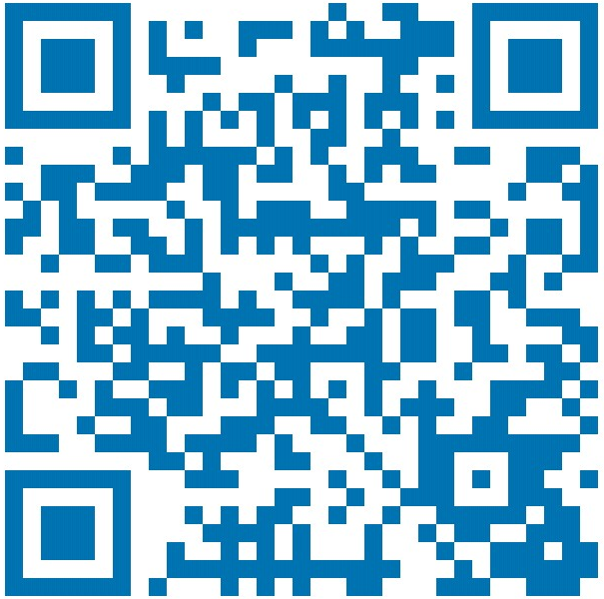
Thank you
Roger Halbheer
roger.halbheer@microsoft.com
+41 78 844 65 55

Slide 10
Modernize identity and endpoint management
Secure the hybrid workforce
Transform employee experiences
Customize secure access for all user types

Slide 11

Strategies for modernization
Modernize authentication and manage identities in the cloud.
Manage devices from the cloud at your own pace.
Improve visibility and control by unifying app management.

Slide 12
Migrate authentication and identities to the cloud
Improve security by managing all identities and access in a single cloud identity solution
Azure Active Directory
Modernize authentication
Block legacy authentication
Sync on-premises identities
Migrate to modern auth with Azure AD Connect and staged roll-out.
Block legacy authentication by default with Conditional Access.
Use a common identity to access resources with Azure AD Connect or Azure AD Connect cloud sync.

Slide 13
Manage endpoints in the cloud at your own pace
Endpoint security, device management, and intelligent cloud actions in a unified management platform
Microsoft Endpoint
Manager
Configuration Manager
Microsoft Intune
Tenant attach
Co-management
Native cloud management
On-premises clients and servers
Windows 10
CM + MDM
Windows, macOS, and mobile devices
Win Server

Slide 14
Unify app management
Secure access to all applications with integrated identity and endpoint management
Azure Active Directory
Microsoft Endpoint
Manager
Cloud apps
On-premises apps
Migrate apps
Desktop and mobile apps
Connect cloud apps with prebuilt integrations in the Azure AD app gallery.
Secure on-premises apps with Azure AD App Proxy and secure hybrid access partners.
Migrate apps on AD FS with Azure AD Connect Health.
Manage and protect mobile and desktop apps with Endpoint Manager.

Slide 15
Secure the hybrid workforce
Modernize identities and endpoints
Transform employee experiences
Customize secure access for all user types

Slide 16
Verify user identities with strong authentication
Secure access to resources with multifactor authentication
Prevent 99.9% of identity attacks with multifactor authentication.
Choose from a broad range of multifactor authentication options.
Make sign-in even more seamless and secure with passwordless authentication.
Including passwordless technology
Microsoft
Authenticator
Windows Hello
FIDO2 Security key
Biometrics
Push notification
Soft tokens OTP
Hard tokens OTP
SMS, voice

Slide 17
Allow only compliant devices to access data
Empower IT to apply controls through endpoint cloud management
Apply data protection policies on mobile devices and applications.
Reduce risk of breaches by quickly remediating detected threats.
Manage device health with detection and response integration and insights.
Set risk-based Conditional Access for devices to protect sensitive information.

Slide 18


Configure adaptive access policies
Control access with smart policies and ​risk assessments
Configure real-time adaptive access policies with Conditional Access.
Set flexible policies based on:
Conditions
Controls
Employee and partner users
Allow access
Sign-in risk
User risk
Device state
Device platform
Location
Applications
Trusted and compliant devices
Limit access
Zero Trust policy
User
Require MFA
Force password reset
Physical and virtual location
Extend real-time policy controls based on event changes during a user session with Continuous Access Evaluation.
Client apps and auth method
Deny access

Slide 19

Safeguard resources with access lifecycle management
Protect, monitor, and audit access to company resources
Provide appropriate access permissions based on roles and group membership.
Reduce risk by reviewing, extending, or revoking access rights for employees and guests.
Simplify the audit process with detailed reports and logs.
Entitlement Management
Access Request Management
Policy & Role Management
Azure AD
Provisioning
Automated Reporting With Alerts
Detailed Audit Logs

Slide 20
Transform employee experiences
Modernize identities and endpoints
Secure the hybrid workforce
Customize secure access for all user types

Slide 21

Strategies for transforming employee experiences
Onboard employees quickly with streamlined provisioning.
Connect your workforce to all apps with single sign-on.
Reduce IT overhead and empower self-service experiences.
Facilitate seamless collaboration across organizational boundaries.

Slide 22
Customize secure access for all user types
Modernize identities and endpoints
Secure the hybrid workforce
Transform employee experiences

Slide 23

Strategies for customizing secure access for all users
Empower frontline workers with streamlined workflows and tailored devices.
Safeguard customer identities and prevent fraud with identity-driven security.
Protect your revenue and customers with fraud protection.

Slide 24
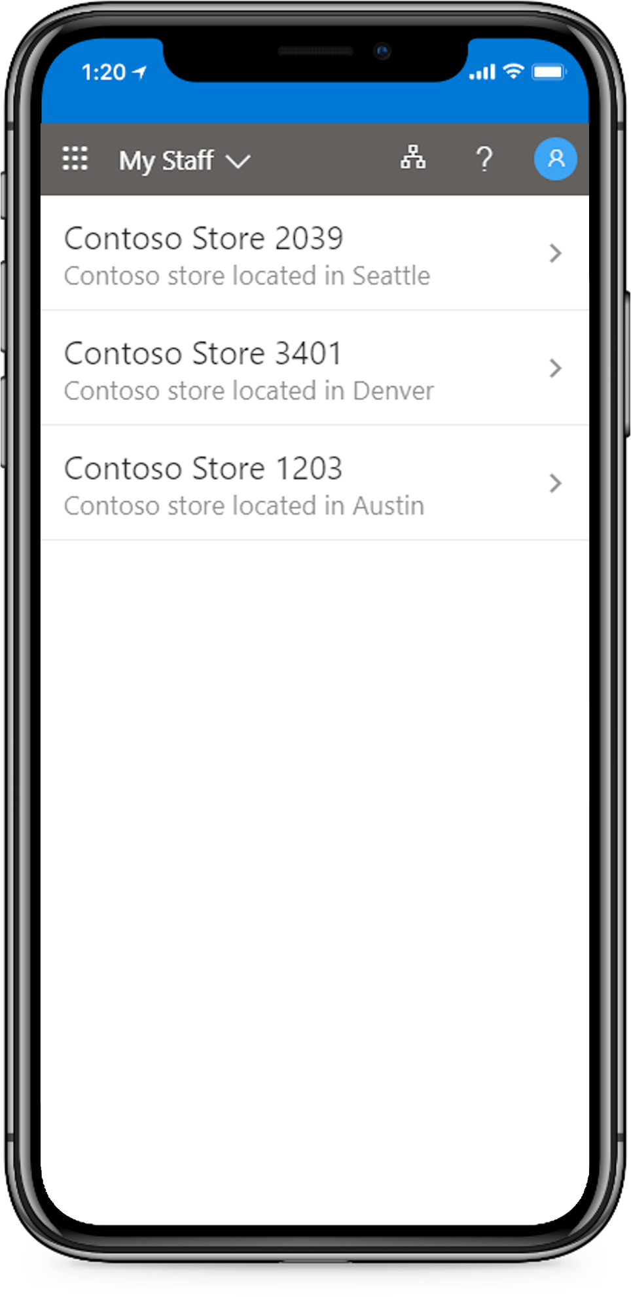
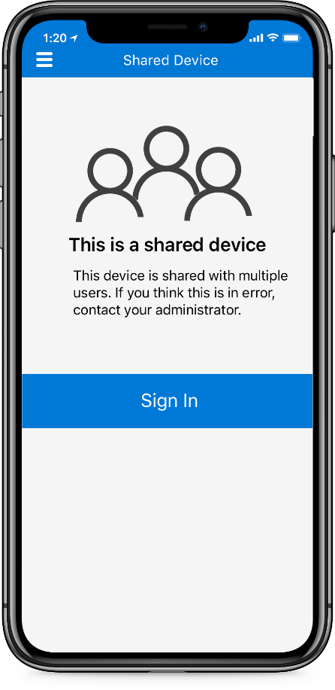
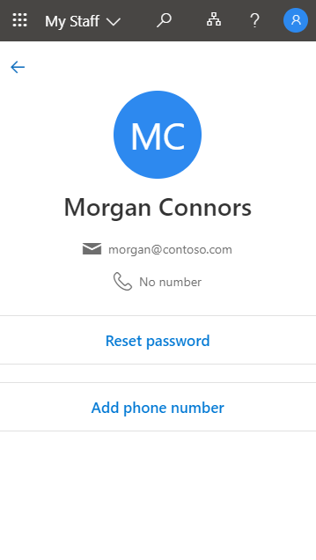
Empowering frontline workers
Deliver frontline solutions with modern identity and endpoint management
Streamline frontline worker access with SMS sign-in.
Provision devices at scale and protect devices used by multiple employees with Shared Device Mode.
Delegate user management to frontline managers with the My Staff portal.

